Slide 1
Problem statement
Exercise 3
Using the truth table method, check whether the following logical consequences hold:
3.

Slide 2
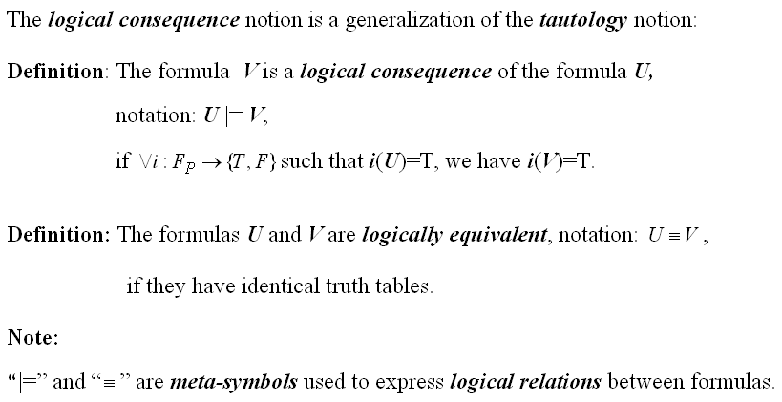
Theoretical results
The logical consequence notion is a generalization of the tautology notion:
Definition: The formula V is a logical consequence of the formula U, (notation:
U |= V), if i: Fp {T, F} such that i(U)=T, we have i(V)=T. All the models of U are also models of V.
Note:
“|=“ is a meta-symbol used to express logical relations between formulas.

Slide 3
U= , V=
 | p | q | r | q r | p q | p r | U | V
i1 | T | T | T | T | T | T | T | T
i2 | T | T | F | F | T | F | F | F
i3 | T | F | T | T | F | T | T | T
i4 | T | F | F | T | F | F | T | T
I5 | F | T | T | T | T | T | T | T
i6 | F | T | F | F | T | T | T | T
i7 | F | F | T | T | T | T | T | T
i8 | F | F | F | T | T | T | T | T

Slide 4
Conclusion
The logical consequence (U |= V) holds because for every i : {p, q, r} { T, F } -> i(U)=T, i(V)=T
From the truth table:
i1(U)=T, i1(V)=T
i3(U)=T, i3(V)=T
i4(U)=T, i4(V)=T
i5(U)=T, i5(V)=T
i6(U)=T, i6(V)=T
i7(U)=T, i7(V)=T
i8(U)=T, i8(V)=T
U is logically equivalent to V if and only if V is a logical consequence of U and U is a logical consequence of V. (U ≡ V if and only if V U and U V)

